Slide 1
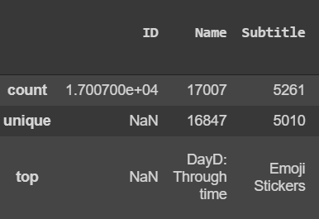
DAVI individual assignment 1
Done by: Lim Chuan Hao, P1922264, DIT/FT/1B/11
About the dataset
17007 rows
18 columns
Description of each column below (Data dictionary)
Business Objectives
What affects the player base of a game?
Active player base defined as, > 100 user rating count. Else no active player base
Factors
What causes a game to have higher ratings?
Factors
Notes:
Data dictionary:
URL
The URL
ID
The assigned ID
Name
The name
Subtitle
The secondary text under the name
Icon URL
512px x 512px jpg
Average User Rating
Rounded to nearest .5, requires at least 5 ratings
User Rating Count
Number of ratings internationally, null means it is below 5
Price
Price in USD
In-app Purchases
Prices of available in-app purchases
Description
App description
Developer
App developer
Age Rating
Either 4+, 9+, 12+ or 17+
Languages
ISO2A language codes
Size
Size of the app in bytes
Primary Genre
The main genre
Genres
Genres of the app
Original Release Date
When it was released
Current Version Release Date
When it was last updated
Business objectives:
Side note:
As for business objective 1, this is shown in story called, player base story.
Business objective 2, is User rating story. Also, games with no player base, i.e. having less that 1 person in user rating count are not considered in this story
What affects the player base of a game?
We are looking at the factors that affects a games player base.
Also, we define a game having an active player base as having more than 100 user rating count.
In this question we are also implicitly asking the question: Does the factor that cause a game to have an active player base also causes the game to have a larger player base on average?
We are looking at the angle where if I were a game developer/company, what kind of game should I make to have the higher chance of having an active player base or have the largest player base on average.
What causes the game to have a higher ratings?
We are asking this question as we would think a higher rated game is ‘better’.
As for this question, we are looking from the angle of what are people that use these apps think are important features/features that they care about.

Slide 2
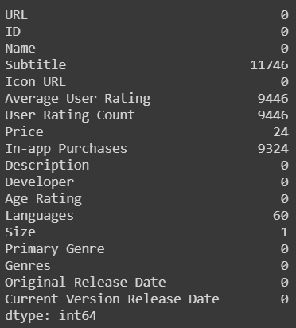
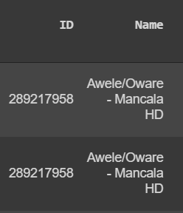
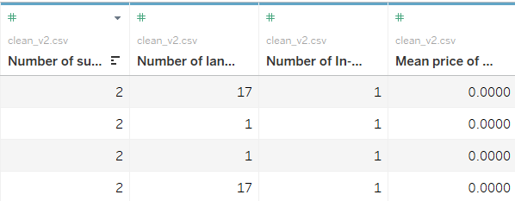
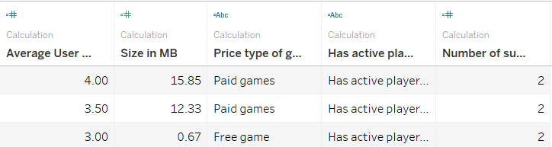
Data wrangling
Cleaned data in Pandas
Creating special calculated fields in pandas
Number of sub-genres
Number of languages
Number of In-app purchases
Mean cost of all In-app purchases
Tableau calculated fields
Average user rating (discrete)
Size in MB
Price type
Have active player base
Number of sub-genres (Discrete)
Notes:
For cleaning data:
Filling in missing values
Subtitle
I replaced all null values with the value ‘None’
Average User Rating & User Rating Count
I noticed the null values happend in pairs. If there was no user rating count, there would be no average user rating
Replaced all null values with 0
Price
I assumed the null values were as the games were free
Replaced the null values with 0
In-app Purchases
I assumed there were no In-app Purchases, thus I replaced them with the string ‘0’
Languages
I filled the missing languages with the mode of the languages, english. ‘EN’
I also did this as most of the games had an english name and description
Size
I filled in the missing value with the mean size of all games
Deleting duplicates:
Deleted all duplicated rows, keeping only one row.
Creating Special calculated fields
Number of sub-genres
Counted number of genres in the genres column, and minus 1. This is to subtract the primary genre
Number of languages
Similar to getting sub-genres
Number of In-app purchases
Similar to sub-genres
Mean cost of all In-app purchases
Took mean of all In-app purchases in a list
Creating calculated fields
Average user rating (discrete)
Duplicated the field to make it discrete
Did this as there were only 10 possible values. 0, 0.5, 1.0, 1.5, 2.0, 2.5, 3.0, 3.5, 4.0, 4.5, 5.0
Size in MB
Took size / 1000000
Price type
There are 3 types, free, pay-to-win, and paid games
Free games are those with no price, and no in-app purchases
Pay-to-win games are those no price, but have in-app purchases
Paid games are those with a price
Have active player base
Defined as: User rating count >= 100. Has an active player base
User rating count < 100. Has no active player base
Number of sub-genres (Discrete)
Same with Average user rating, duplicated the field and made it discrete
Did this as the number was discrete

Slide 3
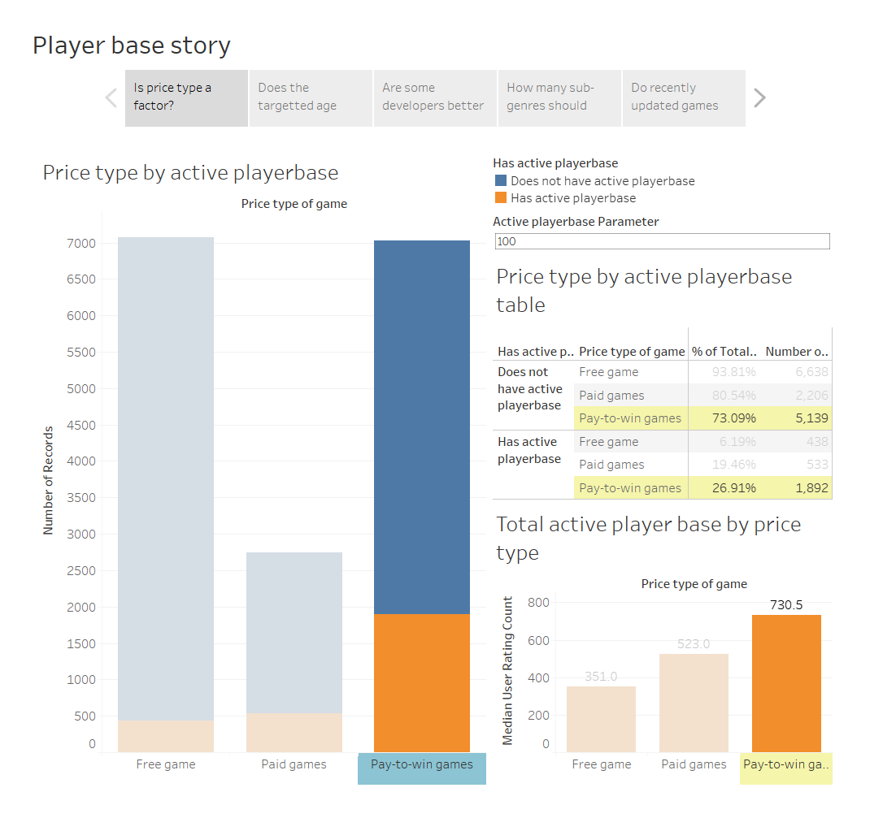
Business objective 1
How does price type affect a game’s player base?
Pay-to-win games has the largest proportion of games having an active player base.
Subsequently, it also has the largest player base on average.
Notes:
Insights
Pay-to-win games has the largest proportion of games having an active player base.
We can see this as from the table, it has the highest percentage of games with an active player base. It is 26.91%
This is compared to the other type of games, with paid games being second with 19.46%.
Thus, on average 1 in 4 pay-to-win games have an active player base.
This is probably as pay-to-win games have in-app purchases or microtransactions. In these type of games, constant user interaction with the game is usually needed.
As well as this, these games are mostly free which also attract people to download and try the game.
Consequently, it also has the largest player base on average.
This is probably due to the reason above as well.
These types of games are able to attract the people who want free games, while also those who want to spend money on games.
This way, it would probably have a larger audience than the other 2 types of games and are most likely to have an active and large player base.

Slide 4
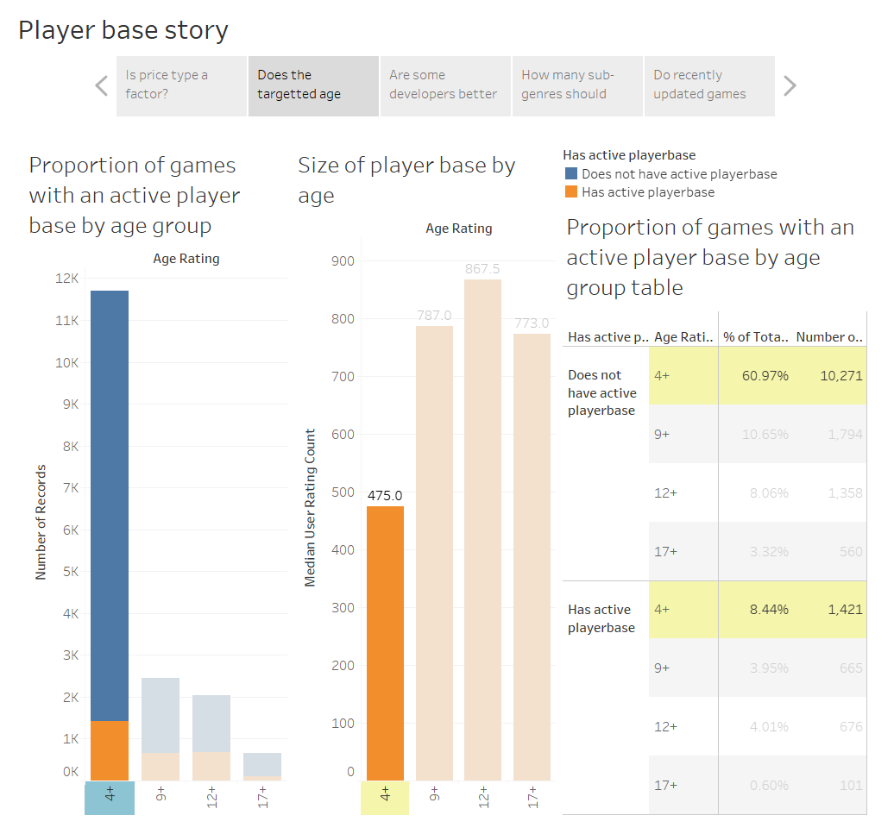
Business objective 1
How does a game’s target age demographic affect it player base
Games targeted to children have the highest proportion of games having an active player base.
However, we see here that games targeting teenagers have a larger player base on average
Notes:
Insights:
Games targeted to children have the highest proportion of games having an active player base.
We can see here that even though games targeted at children have the highest proportion having an active player base, it is still not many.
About 1 in 11 games targeting children have an active player base.
This trend is mostly likely due to the fact that children are less stingy about games and would play anything that look interesting to them.
However, we see here that games targeting teenagers have a larger player base on average
This is interesting as now we see games targeting teenagers have a larger player base on average.
We see here, 9+ has an average of 787 players, while 12+ have the largest number of player at 867.5
This is different from the first insight as we know more games targeted at children have a higher chance of having an active player base.
This could be because teenagers tend to be more dedicated to their games, with mobile games such as clash of clans and mobile legends. These games require the user’s attention for longer periods of time and have incentives year long to keep player coming back.

Slide 5
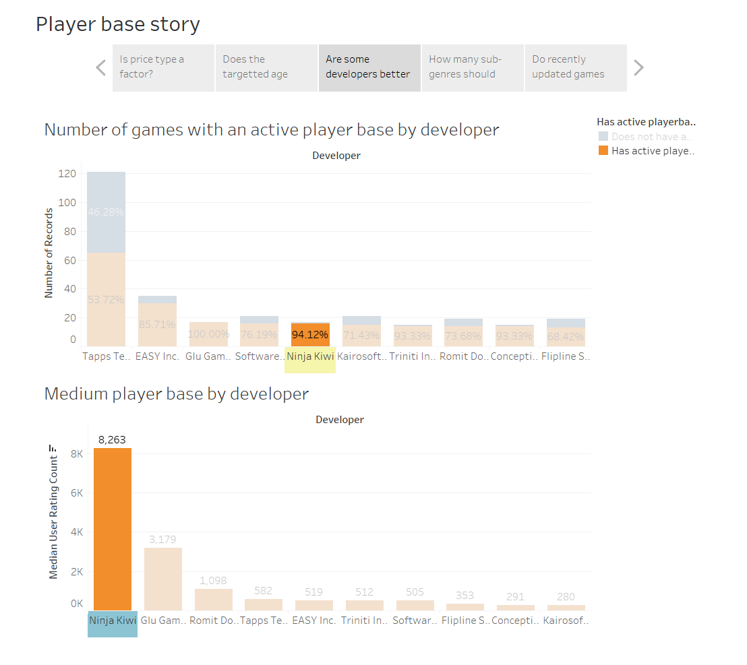
Business objective 1
Are some developers better than others?
Here we can see that taps technology has the most number of games with active player bases.
However, other developers are more consistent in producing games with active player bases.
Lastly Ninja Kiwi, although not having that many games with active player bases, have the largest player base on average.
Notes:
Insights:
Here we can see that taps technology has the most number of games with active player bases.
This is probably as they have produced more games than the other developers seen.
However, other developers are more consistent in producing games with active player bases.
We can see here, there are other developers with supposedly prefer ‘quality over quantity’
This can be seen from how other developers have a larger proportion of their games having an active player base.
For example glu games with 100%.
Lastly Ninja Kiwi, although not having that many games with active player bases, have the largest player base on average.
We also see here that the developers with the most games having an active player base, does not mean each of their games have the largest player base.
Here, Ninja Kiwi has the largest average player base for each of their games.

Slide 6
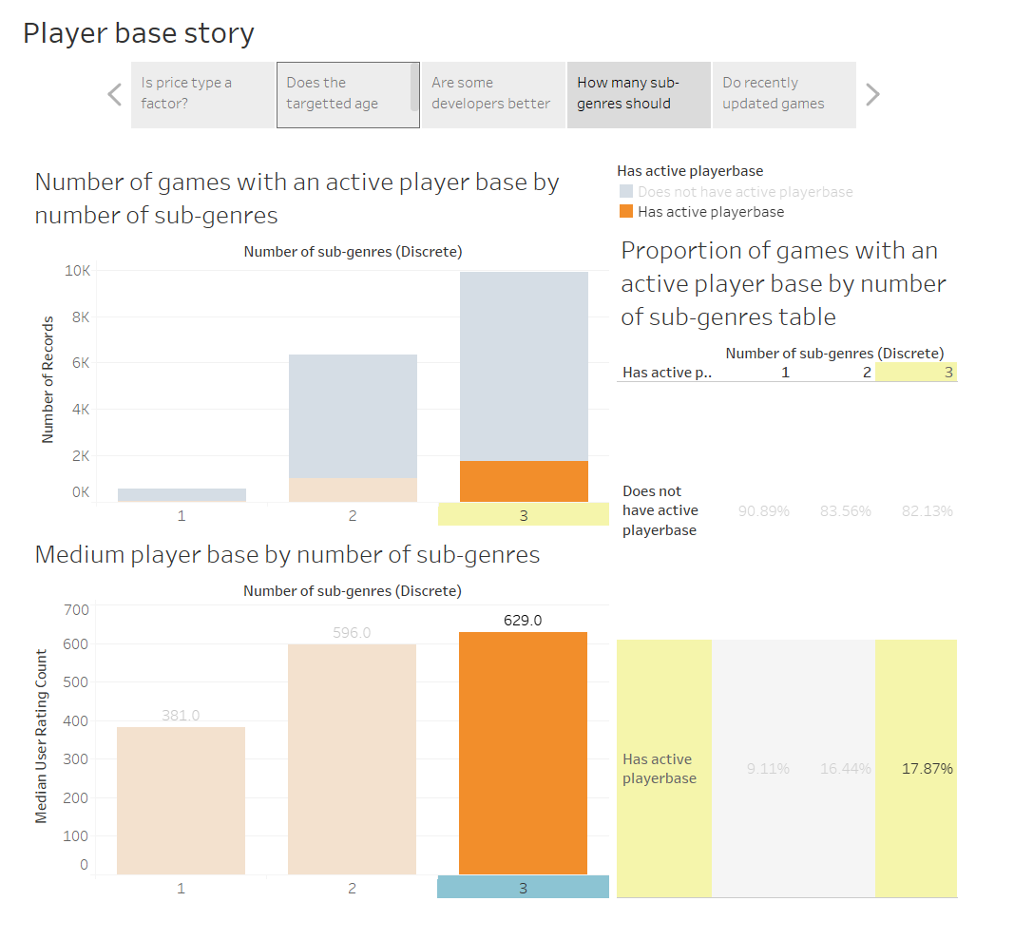
Business objective 1
Does number of sub-genres your game has matter?
We can see games with 3 sub-genres have the largest proportion of games with active player bases.
Subsequently, we can also see that they also have the largest average player base.
Notes:
Insights:
We can see games with 3 sub-genres have the largest proportion of games with active player bases.
17.87% of games with 3 sub-genres have an active player base. Highest proportion. Almost 2 in every 10 games with 3 sub-genres have an active player base.
This is mostly likely due to how a game could cater to different types of people more. As some people may like their genre of games infused with others.
Examples such as puzzle, strategy and adventure games are better together than alone.
Subsequently, we can also see that they also have the largest average player base.
Not too surprisingly this also backs ups the previous statement.
We see here, that more people do play games with 3 sub-genres compared to 2, probably because these games either infuse different sub-genres together, or have the genre that are prefered by some poeple.
Note, there were games with 4 or 5 sub-genres, however we had less than 30 games for those combined. Therefore they are excluded.

Slide 7
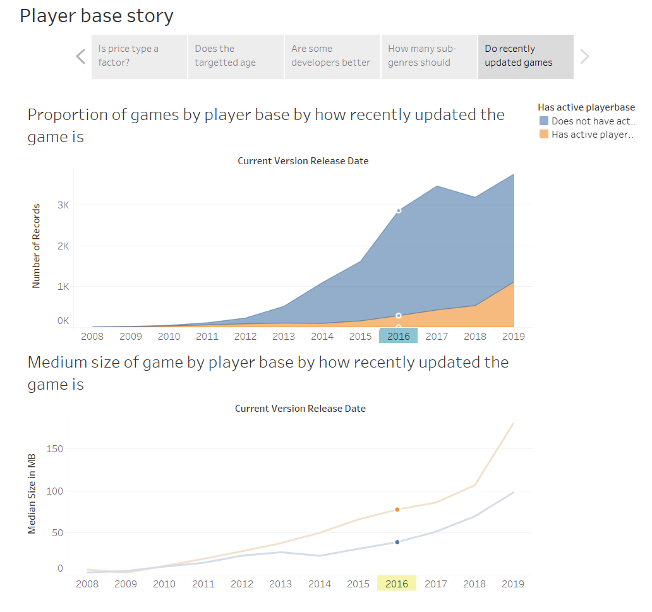
Business objective 1
Do recently updated games have a larger player base?
We can see here that a larger proportion of games updated more recently have an active player base.
We can also see how games have been increasing in size as they are updated more recently.
Also games with active player base are always larger than games with no active player base.
Notes:
Insights:
We can see here that a larger proportion of games updated more recently have an active player base.
This is likely due to the fact that games updated more recently have more content introduced recently.
This would attract both veteran and new players to try out the game.
These games would also be able to actively interact with its player base being update more recently.
We can also see how games have been increasing in size as they are updated more recently.
Also games with active player base are always larger than games with no active player base.
We can also see this working with the above chart.
As games with active player bases are always larger than games with no active player base, this suggest that games with more content are more likely to have an active player base.
We can also see how games with active player bases increase more than games with active player bases. This suggest that even if the games with no active player base increase, they are not able to compete with the shear volume of content the games with active player bases have.

Slide 8
Conclusion for business objective 1 (What affects the player base of a game?)
Overall to create games with the highest chance of having an active player base, it would be in your interest to focus on:
Having a pay-to-win price model
Targeting a children audience
Working with developers such as Glu Games
Having 3 sub-genres
Actively updating your game.
However, if you want to create a game with a larger player base on average, you should focus on:
Targeting youths and teenagers instead
Looking for developers such as Ninja Kiwi that makes quality games
Notes:
Conclusion:
Overall, we can see that some factors in a game can significantly boosts it chance of having an active player base. However, just because your game has a high chance of having an active player base, this does not mean it has a large player base.

Slide 9
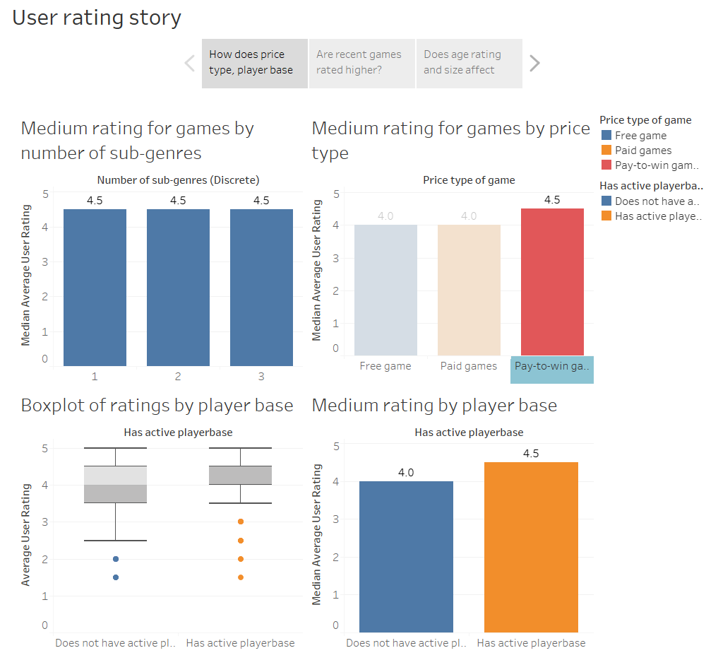
Business objective 2
How does price type, player base and sub-genre affect ratings
We can see here that on average, games with a pay-to-win model and has an active player base have a higher user rating of 4.5
However what is not seen is that looking purely at sub-genres, 1 and 2 sub genres have a higher rating of 4.5 as well
Lastly, games with an active player base have a more consistent spread of high user ratings compared to games with no active player base.
Notes:
Insights:
We can see here that on average, games with a pay-to-win model and has an active player base have a higher user rating of 4.5
This is probably as games with a pay-to-win model are seen as being more user friendly.
As the game is free to download, more content is offered to players, with an optional payment to increase leasure.
This is probably better than having the game behind a pay wall, for paid games.
We can also see that games with an active player base are seen as better games.
This may be due to players seeing a game with people actively playing in it as better.
However what is not seen is that looking purely at sub-genres, 1 and 2 sub genres have a higher rating of 4.5 as well
This is probably as a game seeing to have too many genres at once may confuse people.
We can also see that 1 - 2 genres done well are seen to be better than having many genres.
Lastly, games with an active player base have a more consistent spread of high user ratings compared to games with no active player base.

Slide 10
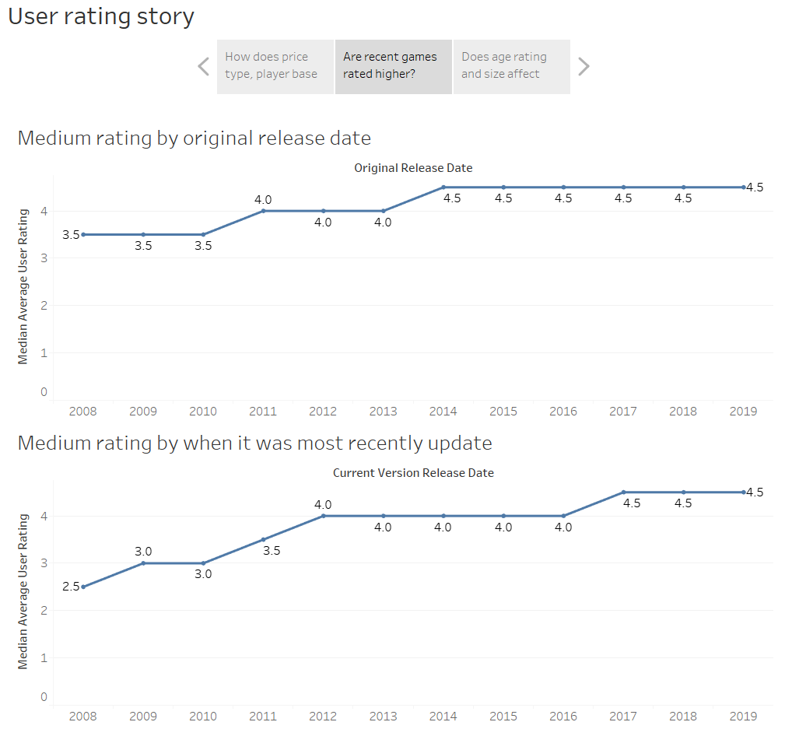
Business objective 2
Are recent games rated higher?
We can see that games released and updated more recently are better rated
Notes:
Insights:
We can see that games released and updated more recently are better rated
This as games that are frequently updated are seen as better. This could be as people want more interesting, updated and the latest content.
New content and updates could keep a game fresh for players which player could see as the game being better.

Slide 11
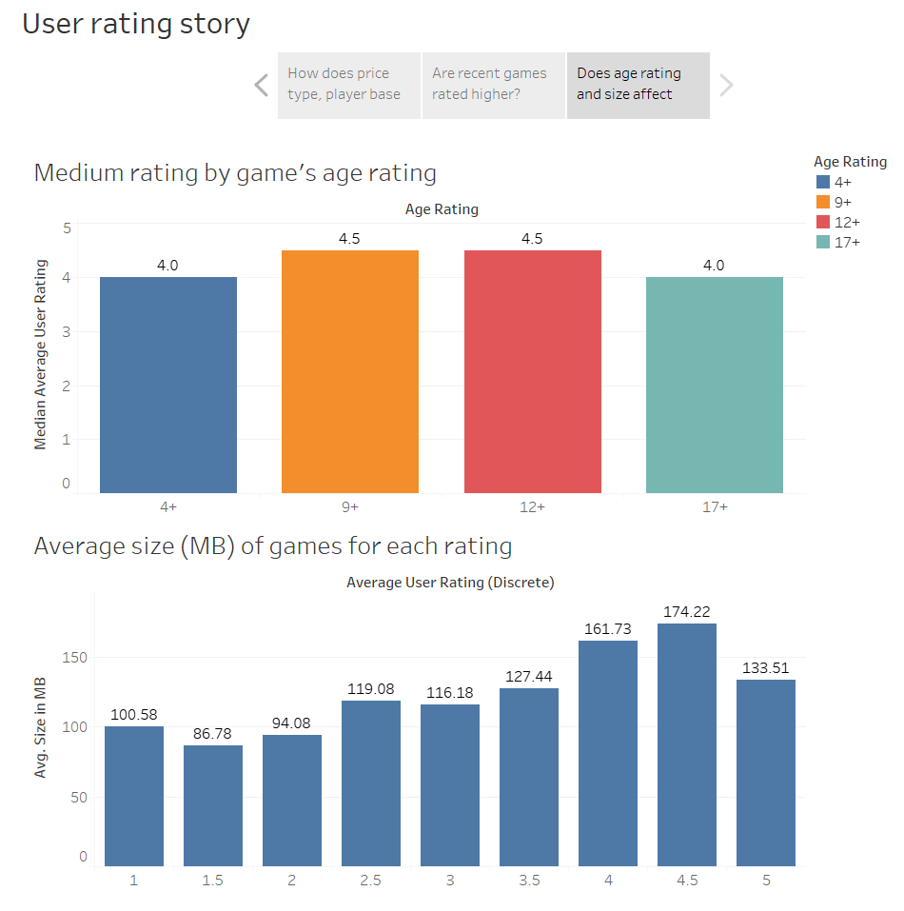
Business objective 2
Does age rating and size affect ratings?
We can see here, games targeted at youths and teenagers are more highly rated on average compared to games for adults or children
We can also see that highly rated games (4 and above), have a large size.
Notes:
Insights:
We can see here, games targeted at youths and teenagers are more highly rated on average compared to games for adults or children
This is likely due to the fact that the target demographic that uses apps and plays these games are teenagers and youths.
As such they would see games targeted at them as better.
We can also see that highly rated games (4 and above), have a large size.
This trend is not as certain, but we can see how on average, games with higher rating are larger.
But games with ratings of 5 are different.
This suggest that size may be inconsistent, or does not play a significant role in affecting a game’s rating.
This could also be because having more content may mean a game is better on average, but it may not be the best.

Slide 12
Conclusion for business objective 2 (What causes a game to have higher ratings?)
Overall, some factors do cause people to view some games as being better than other games.
Therefore if you want to make a game that has a higher rating, you should have:
A pay-to-win model.
With about 1-2 sub genres
Have an active player base if possible
Updated frequently
Targeted at youths and/or teenagers.
Notes:
Conclusion:
We can see here, people do see some features in games that make it ‘better’. However this is by a margin of about 0.5, and the comparison of 4.0 to 4.5 is not much.
We would be able do more analysis, if we had more precise data, such as the rating of all users to 1 decimal place, instead of being rounded to the nearest 0.5.

